Slide 1
Romanticism and Modern Literature
An Introduction
March 10, 2025

Slide 2
Wordsworth’s The Prelude, XI, 105-44
OH! pleasant exercise of hope and joy!
For mighty were the auxiliars which then stood
Upon our side, we who were strong in love!
Bliss was it in that dawn to be alive,
But to be young was very heaven!--Oh! times,
In which the meagre, stale, forbidding ways
Of custom, law, and statute, took at once
The attraction of a country in romance!
오, 희망과 기쁨이 행복하게 발휘되는 순간이여!
그때 우리 편에 섰던 조력자들은 강력했고 우리 또한 사랑 속에서 단단했으니까.
그 여명에 살아있었던 것만으로도 큰 기쁨이었지만,
그것도 그때 젊은이였다는 것은 그야말로 천상의 축복이었다!
오! 그 시절이여! 그때는 관습과 법률, 법령들이 강제하는 빈약하고, 철 지난 규제의 방식들조차
동화속의 나라처럼 갑자기 매력적으로 느껴졌다!

Slide 3
Wordsworth’s The Prelude, XI, 105-44
When Reason seemed the most to assert her rights,
When most intent on making of herself
A prime Enchantress--to assist the work,
Which then was going forward her name!
Not favoured spots alone, but the whole earth,
The beauty wore of promise, that which sets
(As at some moment might not be unfelt
Among the bowers of paradise itself)
The budding rose above the rose full blown.
*"The Sorcerer's Apprentice" (German: "Der Zauberlehrling") is a poem by Johann Wolfgang von Goethe written in 1797.
*"The Bower of Bliss" in Spenser's "The Faerie Queene" (canto xii, 38-87) is an earthly paradise of sensual joys.
이성이 마치 마법사의 제자가 스스로 마법사가 되어보려고
자기 권리를 한껏 주장하는 것 같았고,
그렇게 해서 그 당시 자신의 이름을 걸고 진행되던 일들을 도우려고 하는 것 같았다!
특혜 받은 특별한 곳들 만이 아니라
전 세계가 아름다운 약속의 땅이 되어,
이미 만개한 장미 위에 또 다른 봉우리를 맺어 놓았다.
마치 어떤 순간에는 온 천지가 천국의 정자가 된 것같았다.

Slide 4
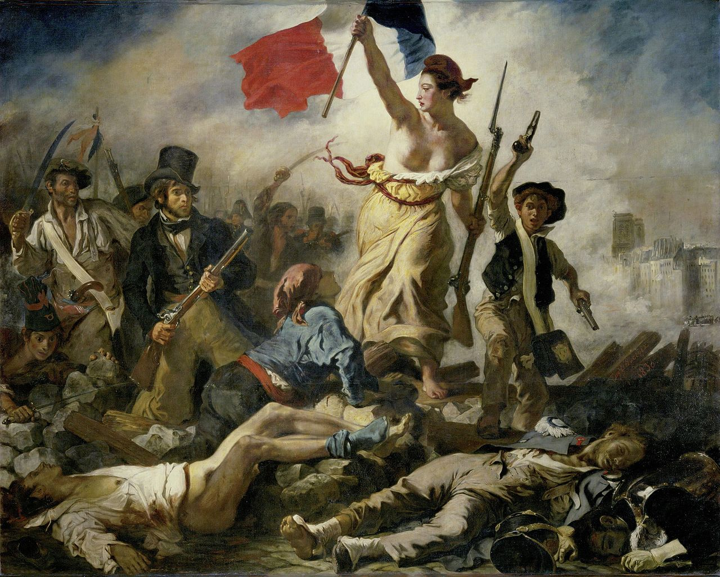
Eugène Delacroix, “Liberty leading the People”(1830)

Slide 5
The Romantic Period: 1785-1830(Norton Introduction)
1789—1815: Revolutionary and Napoleonic period in France.
1789: The Revolution begins with the assembly of the States General in May and the storming of the Bastille on July 14.
1793: King Louis XVI executed; England joins the alliance against France.
1793—94: The Reign of Terror under Robespierre.
1804: Napoleon crowned emperor.
1807: British slave trade outlawed (slavery abolished throughout the empire, including the West Indies, twenty-six years later).
1811—20: The Regency—George, Prince of Wales, acts as regent for George III, who has been declared incurably insane.
1815: Napoleon defeated at Waterloo.
1819: Peterloo Massacre.
1820: Accession of George IV.
1829: The Catholic Relief Act is passed.
1830: King George IV dies and Willian IV ascends.
1832: The Great Reform Act is passed.
1837: Queen Victoria ascends.

Slide 6
The Romantic Period: 1785-1830(Major Romantics)
1757: Blake born
1770: Wordsworth born
1772: Coleridge born
1788: Byron born
1789-1815: Revolutionary and Napoleonic period in France
1789: The Revolution begins with the assembly of the States-General in May and the storming of the Bastille on July 14.
1792: Shelley born
1793: King Louis XVI executed: England joins the alliance against France.
1793-94: The Reign of Terror under Robespierre.
1795: Keats born
1804: Napoleon crowned emperor.-
1815: Napoleon defeated at Waterloo
1821: Keats died
1822: Shelley died
1824: Byron died
1827: Blake died
1834: Coleridge died
1850: Wordsworth died

Slide 7
“The Romantics”(a British Library Article by Stephanie Forward)
In 1762 Jean-Jacques Rousseau declared in The Social Contract: ‘Man is born free, and everywhere he is in chains.’ During the Romantic period major transitions took place in society, as dissatisfied intellectuals and artists challenged the Establishment. In England, the Romantic poets were at the very heart of this movement. They were inspired by a desire for liberty, and they denounced the exploitation of the poor. There was an emphasis on the importance of the individual; a conviction that people should follow ideals rather than imposed conventions and rules. The Romantics renounced the rationalism and order associated with the preceding Enlightenment era, stressing the importance of expressing authentic personal feelings. They had a real sense of responsibility to their fellow men: they felt it was their duty to use their poetry to inform and inspire others, and to change society.

